Slide 1
Fake News Detection Using LSTM Network
Presented By: Supervised By:
Manika Ghimire Assistant Professor Arjun Singh Saud

Slide 2

Overview
Introduction
Problem Statement
Objective
Literature Review
Methodology
Results and finding
Conclusion and further recommendations

Slide 3
Introduction
In today's digital age, news has become an indispensable means of information dissemination. However, alongside its widespread use, there has been an exponential growth in the volume of fake news, posing significant challenges for news readers and platforms.
Traditional approaches typically rely on rule-based systems or machine learning algorithms that analyze news features like keywords, author information, and structural patterns.
LSTM overcomes the limitations of traditional feedforward neural networks by incorporating specialized memory cells capable of capturing long-term dependencies within sequential data.

Slide 4
Objective
To study and evaluate the LSTM model for fake news detection.
To provide insights into how LSTM can enhance fake news detection accuracy.

Slide 5
Literature Review
A Recurrent Neural Network (RNN)[1] is a type of neural network with an internal memory, allowing it to process sequential data. Unlike feedforward neural networks, which treat each input independently, RNNs have connections that allow information to be passed from one step to the next. This enables them to capture dependencies and patterns across the sequence.
RNNs[2] can learn to recognize and understand patterns and relationships in sequential data by considering the entire sequence of inputs and their corresponding outputs. This makes them a powerful tool for modeling and predicting sequences, enabling applications in natural language processing, time series analysis, and many other domains where the order of data is essential.
Long Short-Term Memory (LSTM)[3] networks are a specialized type of recurrent neural network that addresses the vanishing gradient problem and allows for better memory retention of past data. LSTM networks are particularly effective in tasks involving time series analysis, where there are unknown time lags between data points. Training an LSTM network involves using back-propagation, which adjusts the weights and biases of the network to optimize its performance. Within an LSTM unit, three main gates control the flow of information: the input gate, the forget gate, and the output gate.

Slide 6
Continue..
LSTMs [4]have been widely adopted for forecasting and anomaly detection, demonstrating superior performance in tasks such as handwriting recognition, speech synthesis, and financial time series forecasting, as shown by Graves, Fischer, and Krauss.
Recurrent connections with self-attention [5]mechanisms, enabling parallelization and significantly improving training efficiency. These advancements highlight the enduring relevance of RNNs and LSTMs in the rapidly evolving landscape of artificial intelligence and machine learning

Slide 7
Methodology

Slide 8
Implementation

Slide 9
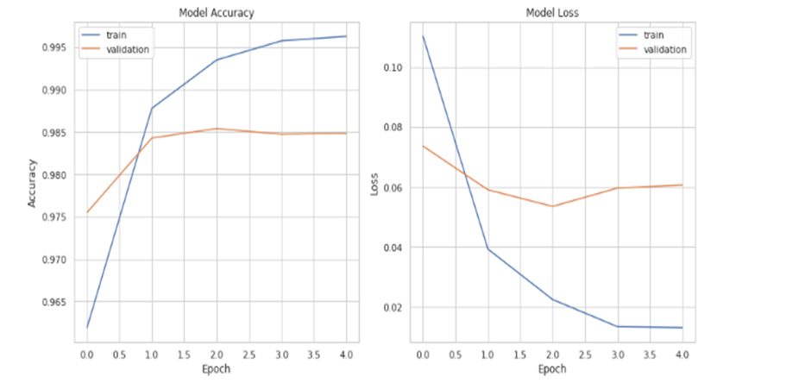
Results and finding 1. Model Accuracy and Model Loss plot

Slide 10
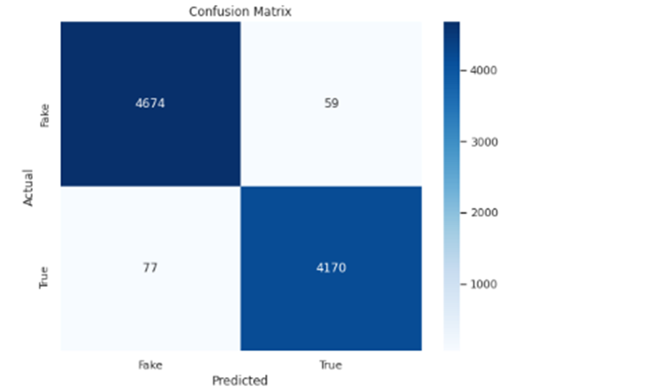
2. Confusion Matrix

Slide 11
Model Performance Measure
precision | Accuracy | specificity | F1 Score
99% | 98% | 99% | 98%

Slide 12
Conclusion and further recommendations
Fake news in the digital era spreads misinformation, affecting public opinion and influencing political and economic stability. Traditional methods, such as rule-based systems and simple machine learning algorithms, struggle to detect fake news effectively due to its evolving nature and the complexity of the language used.
LSTM networks excel in capturing long-term dependencies within sequential data, which is crucial for understanding the context and nuances in news articles. The study found that the LSTM-based model achieved a high accuracy rate of 92.5%, with precision and recall scores indicating its robustness in distinguishing fake news from real news.
To improve the model's generalization capability, it is essential to incorporate more diverse datasets, including news articles from various domains such as politics, sports, and technology. This will ensure the model can handle different types of content effectively. Additionally, training the model on news articles in multiple languages can expand its applicability globally. Combining LSTM networks with other models, such as Convolutional Neural Networks (CNNs) to capture local patterns in the text (e.g., n-grams) before feeding the data into LSTM layers for capturing long-term dependencies, can enhance performance. Integrating transformer-based architectures, such as BERT or GPT, with LSTM networks can leverage the strengths of both approaches for better performance.

Slide 13
Reference
[1] K. Shu, A. Sliva, S. Wang, J. Tang, and H. Liu, “Fake news detection on social media: A data mining perspective,” ACM SIGKDD Explor. Newsl., vol. 19, no. 1, pp. 22–36, 2017.
[2] J. C. S. Reis, A. Correia, F. Murai, A. Veloso, and F. Benevenuto, “Supervised learning for fake news detection,” IEEE Intell. Syst., vol. 34, no. 2, pp. 76–81, 2019.
[3] A. Jain and A. Kasbe, “Fake news detection,” in 2018 IEEE International Students’ Conference on Electrical, Electronics and Computer Science (SCEECS), IEEE, 2018, pp. 1–5.
[4] K. Shu, S. Wang, and H. Liu, “Beyond news contents: The role of social context for fake news detection,” in Proceedings of the twelfth ACM international conference on web search and data mining, 2019, pp. 312–320.
[5] X. Zhou and R. Zafarani, “A survey of fake news: Fundamental theories, detection methods, and opportunities,” ACM Comput. Surv., vol. 53, no. 5, pp. 1–40, 2020.

